Slide 1
Flip-Flops

Slide 2
Flip-Flop
The state of a latch or flip-flop is switched by a change in the control input. This momentary change is called a trigger, and the transition it causes is said to trigger the flip-flop.
Sequential circuit has a feedback path from the outputs of the flip-flops to the input of the combinational circuit.
The inputs of the flip-flops are derived in part from the outputs of the same and other flip-flops.
The state transitions of the latches start as soon as the clock pulse changes to the logic-1 level.
The new state of a latch appears at the output while the pulse is still active.
Flip-flop circuits are constructed in such a way as to make them operate properly when they are part of a sequential circuit that employs a common clock.
The key to the proper operation of a flip-flop is to trigger it only during a signal transition.
A clock pulse goes through two transitions: from 0 to 1 and the return from 1 to 0.

Slide 3
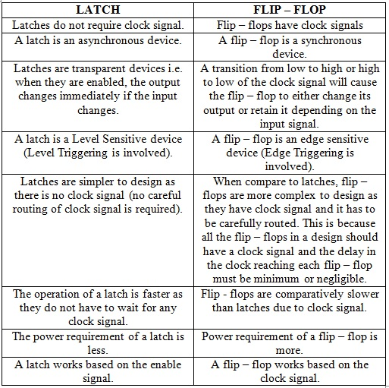

Slide 4
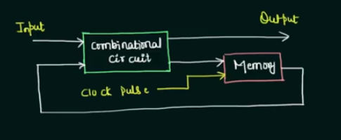
Triggering Method
Memory: flip-flop
Clock pulse: control input
Trigger the memory element →state stored in it is switched(change from one state to the other state depending upon the input and previous state in it(memory))
State of the circuit will be changed depending upon the clock pulse
Notes:
Sequential circuit: Combinational +Memory
What Is a Triggering Event? A triggering event is a tangible or intangible barrier or occurrence which, once breached or met, causes another event to occur

Slide 5

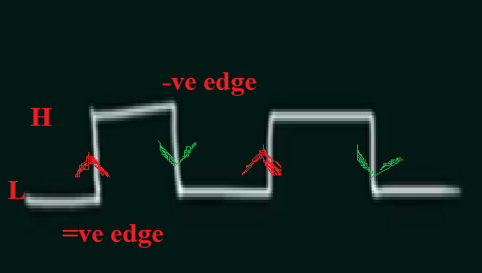
Types:
Level triggering
Edge triggering
Level Triggering:
Clock remains high then there will be a
Transition in latch/flip-flop
Edge Triggering:
+ve edge(Low to high)
-ve edge(high to low)
Notes:
+ve edge:When memory element will trigger then clock pulse from low to high there will be change in memory element. It will switch form one state to other state.
-ve edge: when it goes from high to low then memory will trigger.
On both edges state will change

Slide 6
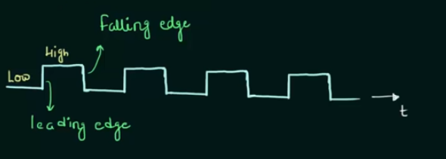
What is Clock?
T
Edge Triggering
Notes:
Decide the speed of circuit by changing clock frequency.
Clock → signal(that goes from low to high then high to low and repeats)
Time for which it is high= time for which it is low

Slide 7
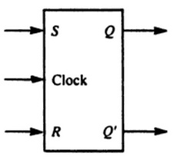
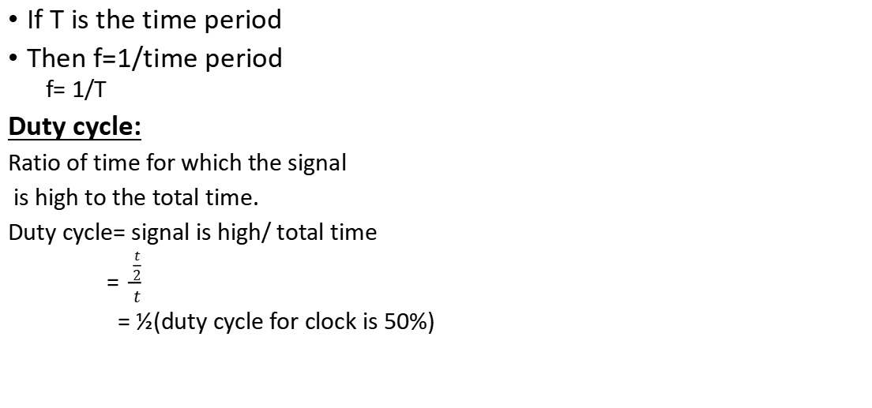
If T is the time period
Then f=1/time period
f= 1/T
Duty cycle:
Ratio of time for which the signal
is high to the total time.
Duty cycle= signal is high/ total time
= $\frac{\frac{t}{2}}{t}$
= ½(duty cycle for clock is 50%)
SR Flip-Flop Graphical Symbol
Notes:
To make circuit run faster increases the frequency or decrease the time period.
Duty cycle: 50% of time clock is high or 50% time clock is low

Slide 8
Types of Flip-Flop
Set-Reset (SR) flip-flop or Latch.
JK flip-flop.
D (Data or Delay) flip-flop.
T (Toggle) flip-flop.

Slide 9
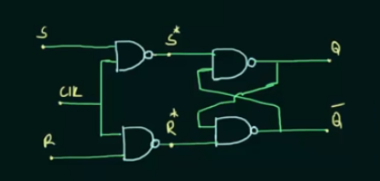
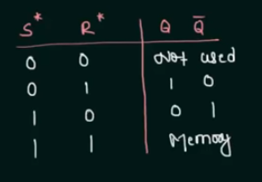
SR Flip-Flop
SR Flip-Flop
SR Latch T.T with NAND gate
Notes:
Clock: control input

Slide 10
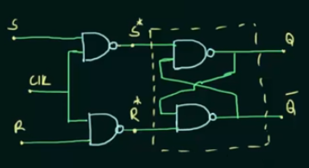
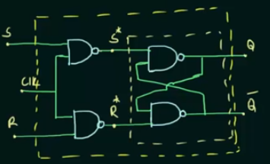
Highlighted box is SR Latch with NAND gate
Outer Highlighted box is SR Flip-Flop

Slide 11
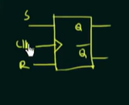
S* = (S.Clk)’
S* =S’+ Clk’
R*= (R.clk)’
R*= R’+Clk’
When clk=0
S*=S’+clk’
S*= 1
R*=R’+clk’
R*=1
When clk=1 S*=S’, R*=R’
Case i)S=R=0:
S*=1, R*=1
Case ii) S=0, R=1
S*=1, R*=0
Case iii) S=1,R=0
S*=0, R=1
Case iv) S=R=1
S*=0, R*=0

Slide 12
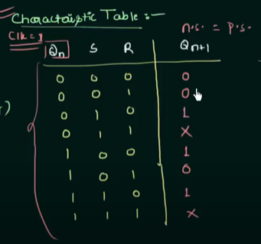
Clk | S | R | Q | Q’
0 | X | X | Memory
1 | 0 | 0 | Memory
1 | 0 | 1 | 0 | 1
1 | 1 | 0 | 1 | 0
1 | 1 | 1 | Not used
Truth Table for SR flip-flop

Slide 13
Qn | S | R | Qn+1
0 | 0 | 0 | 0
0 | 0 | 1 | 0
0 | 1 | 0 | 1
0 | 1 | 1 | X/invalid
1 | 0 | 0 | 1
1 | 0 | 1 | 0
1 | 1 | 0 | 1
1 | 1 | 1 | X/Invalid
Clk | S | R | Qn+1
0 | X | X | Qn
1 | 0 | 0 | Qn
1 | 0 | 1 | 0
1 | 1 | 0 | 1
1 | 1 | 1 | invlaid
Characteristic Table
Truth Table

Slide 14
Qn | Qn+1 | S | R
0 | 0 | 0 | X
0 | 1 | 1 | 0
1 | 0 | 0 | 1
1 | 1 | X | 0
An excitation table shows the minimum inputs that are necessary to generate a particular next state (in other words, to "excite" it to the next state) when the current state is known. They are similar to truth tables and characteristic tables, but rearrange the data so that the current state and next state are next to each other on the left-hand side of the table, and the inputs needed to make that state change happen are shown on the right side of the table.
Excitation Table

Slide 15
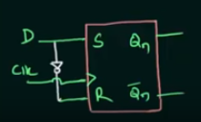
D-(Data) Flip-Fop
Clk | D | Qn+1
0 | X | Qn
1 | 0 | 0
1 | 1 | 1
Truth Table
Notes:
Disadvantages of D flip flop :A delay flip flop in a circuit increases the circuit's size, often to about twice the normal. Additionally, they also make the circuits more complex.

Slide 16
Qn | D | Qn+1
0 | 0 | 0
0 | 1 | 1
1 | 0 | 0
1 | 1 | 1
Qn | Qn+1 | D
0 | 0 | 0
0 | 1 | 1
1 | 0 | 0
1 | 1 | 1
Characteristic Table
Excitation Table
Notes:
an excitation table shows the minimum inputs that are necessary to generate a particular next state when the current state is known.
Design characterstics table by using T.T

Slide 17
Disadvantages of SR and D
When the S and R inputs of an SR flipflop are at logical 1, then the output becomes unstable and it is known as a race condition. So, the main disadvantage of the SR flip flop is invalid output when both inputs are high.
Disadvantages of D flip flop :A delay flip flop in a circuit increases the circuit's size, often to about twice the normal. Additionally, they also make the circuits more complex.

Slide 18
JK Flip Flop
JK Flip Flop is a universal flip-flop that makes the circuit toggle between two states and is widely used in shift registers, counters, PWM(pulse width modulation) and computer applications.
It is a flip-flop, that can be either active-high or active-low based on the signal applied.
It is an improved version of the SR Flip Flop and prevents the circuit from going in an invalid state.
As the name suggests, it helps the circuit toggle between two states.
The JK Flip-flop is also widely known as a programmable flip-flop as it can disguise other flip-flops based on the inputs applied.

Slide 19
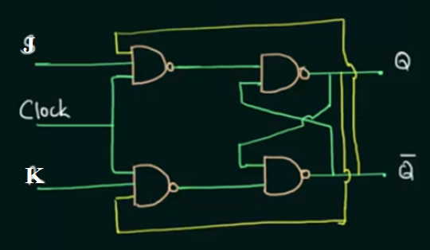
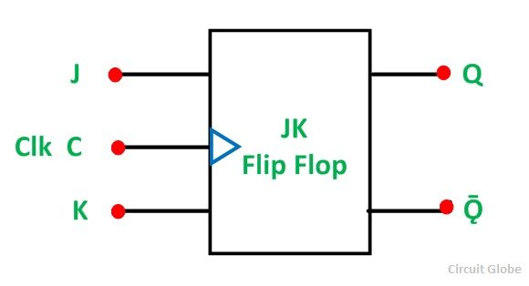
JK Flip-Flop
Notes:
JK Flip Flop is a universal flip-flop that makes the circuit toggle between two states and is widely used in shift registers, counters, PWM(pulse width modulation) and computer applications.
It is a flip-flop, that can be either active-high or active-low based on the signal applied.
It is an improved version of the SR Flip Flop and prevents the circuit from going in an invalid state.
As the name suggests, it helps the circuit toggle between two states.
The JK Flip-flop is also widely known as a programmable flip-flop as it can disguise other flip-flops based on the inputs applied.

Slide 20
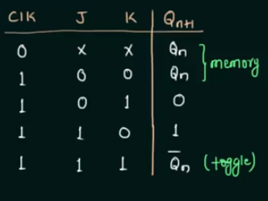
Qn | J | K | Qn+1
0 | 0 | 0 | 0
0 | 0 | 1 | 0
0 | 1 | 0 | 1
0 | 1 | 1 | 1
1 | 0 | 0 | 1
1 | 0 | 1 | 0
1 | 1 | 0 | 1
1 | 1 | 1 | 0

Slide 21
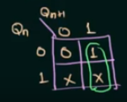
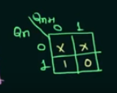
Qn | Qn+1 | J | K
0 | 0 | 0 | X
0 | 1 | 1 | X
1 | 0 | X | 1
1 | 1 | X | 0
J= Qn+1
K= (Qn+1)’
Excitation table
Notes:
Excitation table

Slide 22
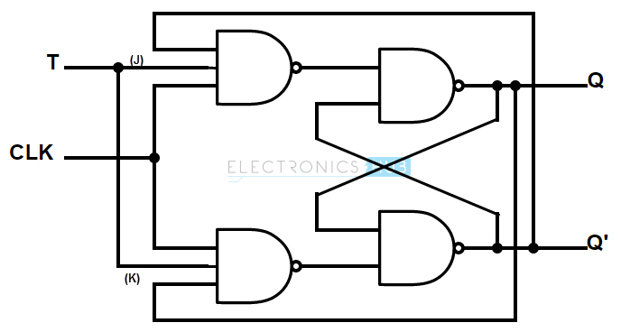
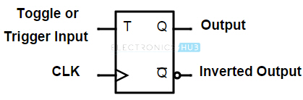
Toggle Flip-Flop
Notes:
T flip – flop is also known as “Toggle Flip – flop”. To avoid the occurrence of intermediate state in SR flip – flop, we should provide only one input to the flip – flop called Trigger input or Toggle input (T). Then the flip – flop acts as a Toggle switch. Toggling means ‘Changing the next state output to complement of the present state output’.

Slide 23
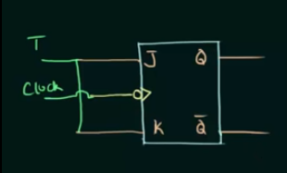
Clk | T | Qn+1
0 | X | Qn/memory
1 | 0 | Qn
1 | 1 | Qn’ (toggle)

Slide 24
Qn | T | Qn+1
0 | 0 | 0
0 | 1 | 1
1 | 0 | 1
1 | 1 | 0
Qn | Qn+1 | T
0 | 0 | 0
0 | 1 | 1
1 | 0 | 1
1 | 1 | 0
Excitation table
Characteristic Table
Notes:
Excitation table

